Slide 1
ReImagine
Vj and team

Slide 2

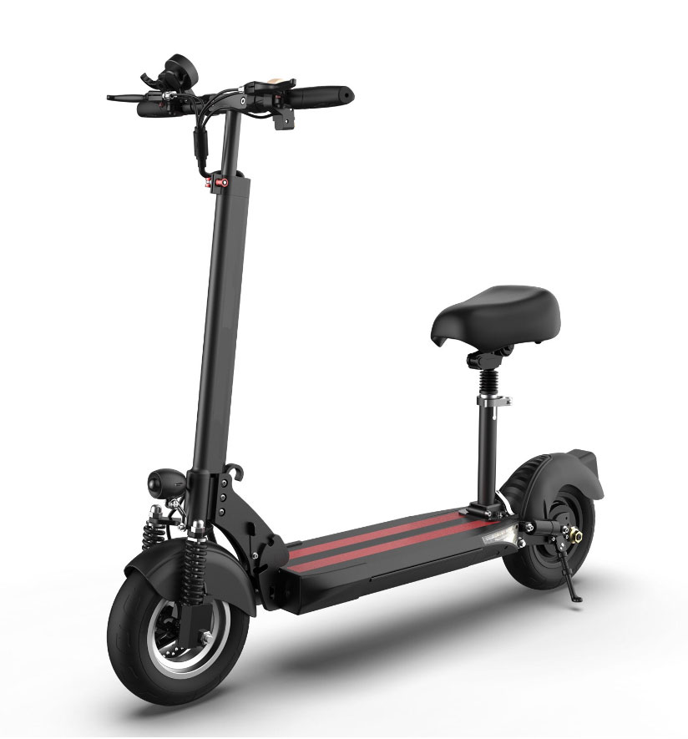
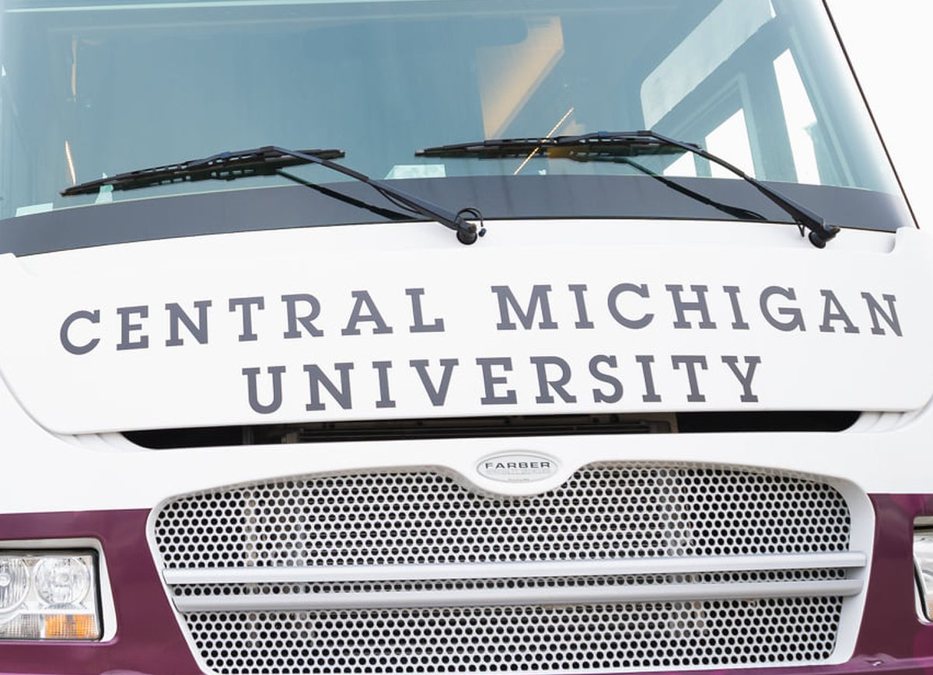
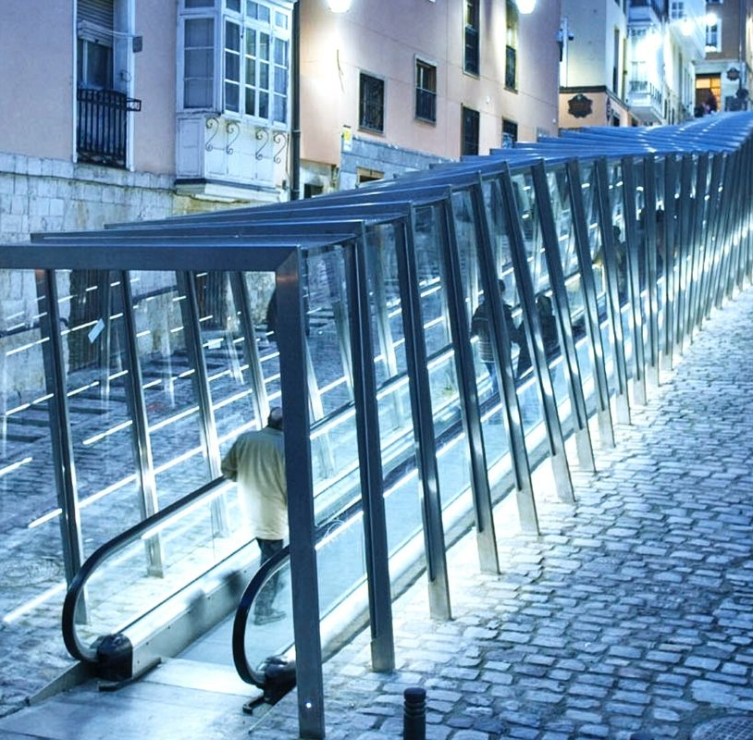
Agenda
Transport And Sustainability
For students

Slide 3
First Let us divide the mount pleasant into two parts in campus and out campus, where In Campus is Inside the campus and Out Campus is outside the campus.
Mount
Pleasant
IN CAMPUS
OUT CAMPUS

Slide 4

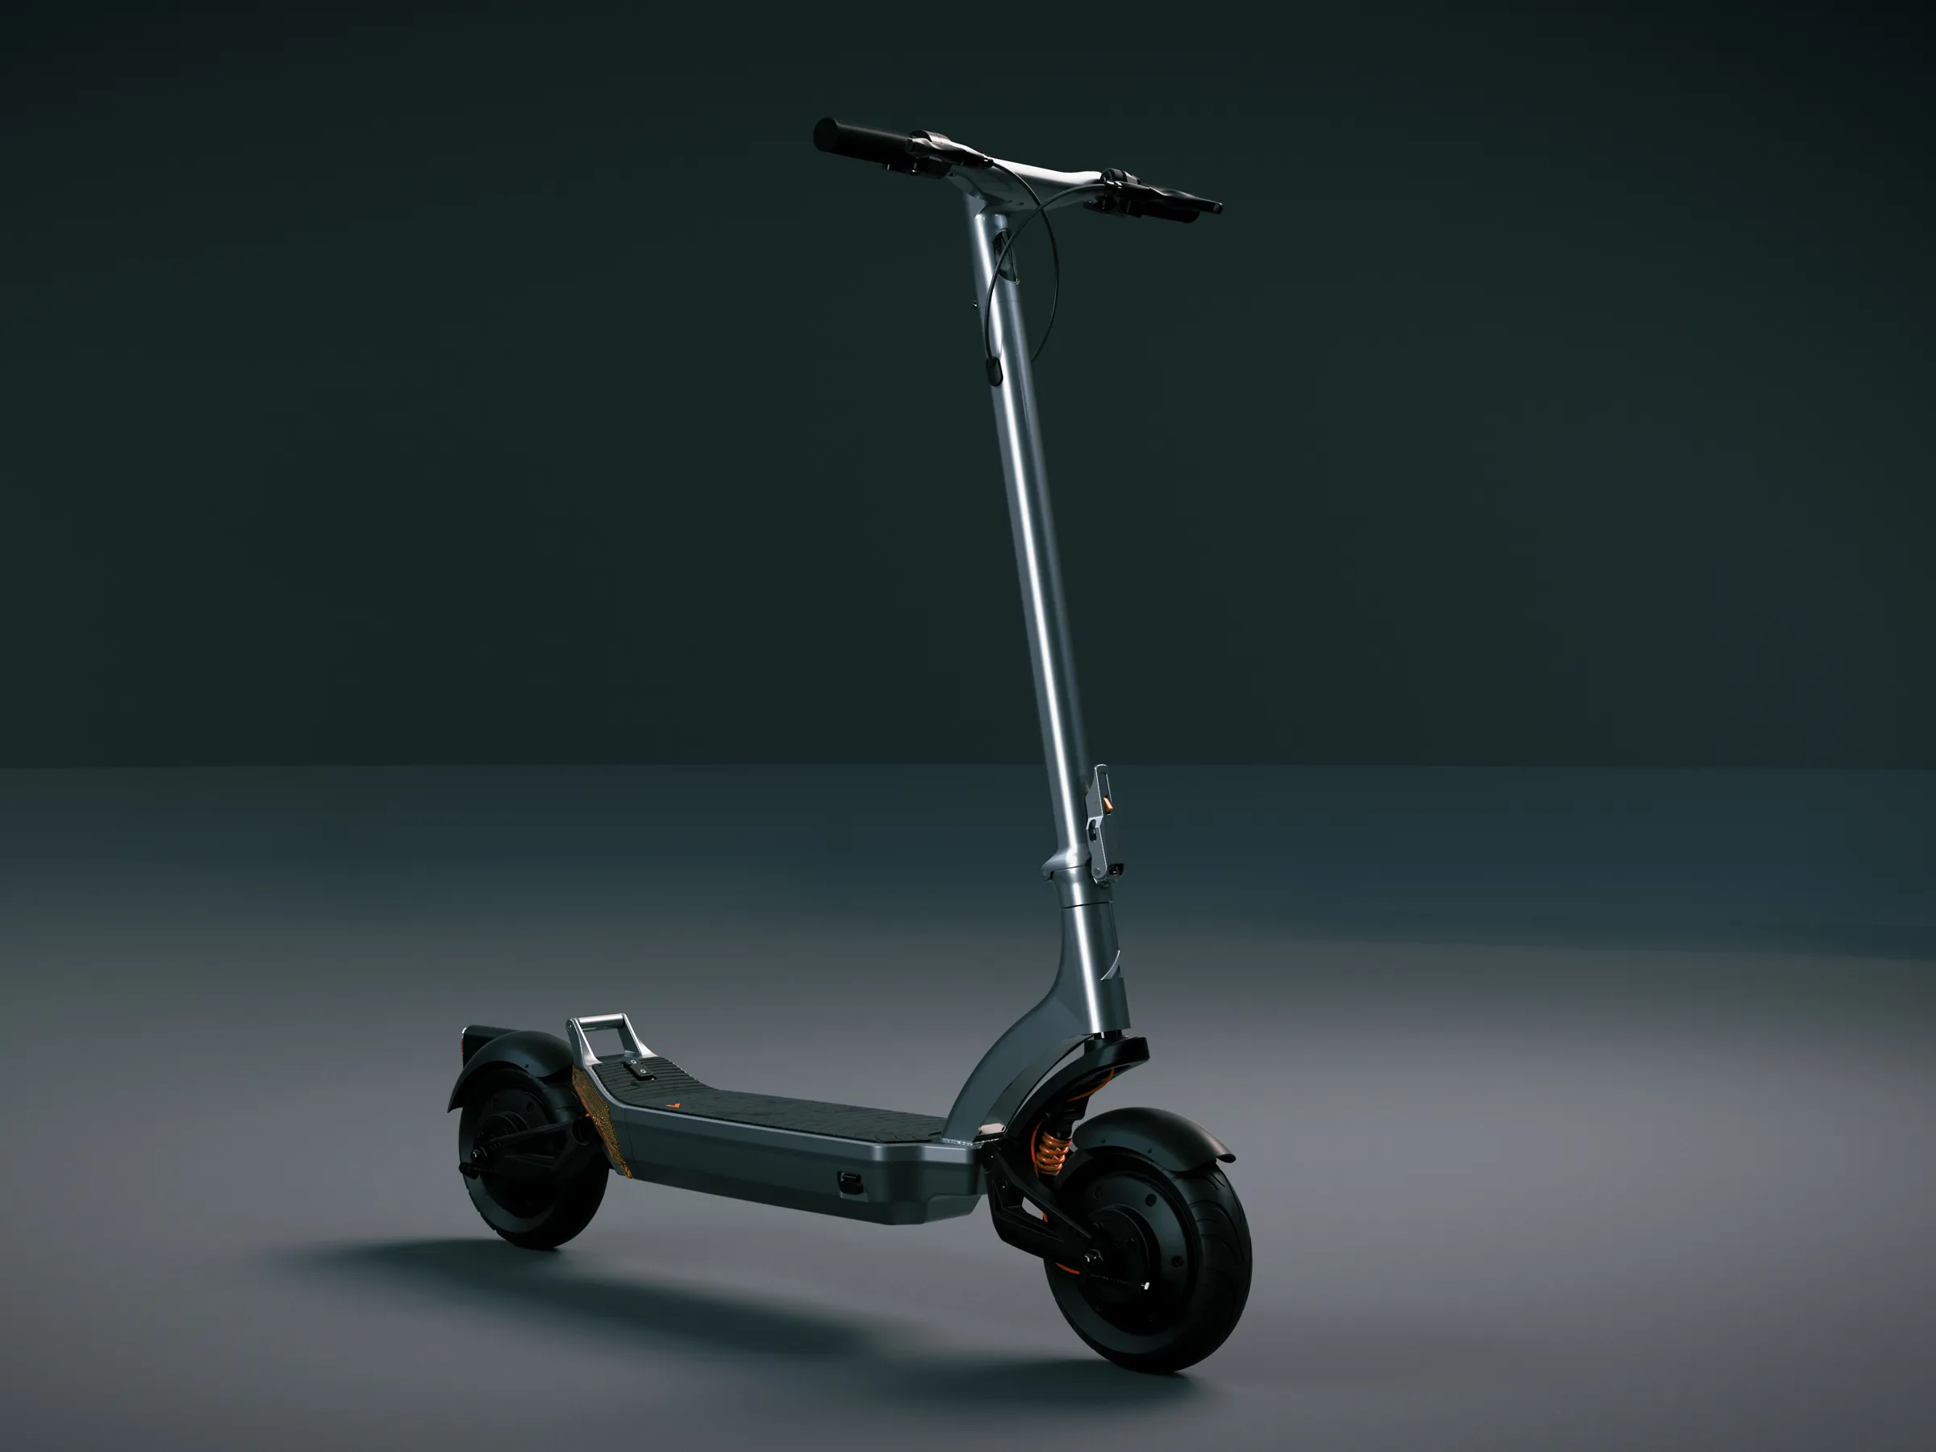
Case Study
E-SCOOTERS And BIKeS

Slide 5
Case Study 1
In the campus we could place e-scooters operated by an app exclusive to students only. The App marks the e-scooters booked and tracks them and also shows the un-booked scooters. And while in the out (out of campus) we could place bikes which helps the students to go to the grocery store or shopping. The E-scooters can be activated by Student ID only and can be used free for 30 mins and then after 30 mins it will cost them around $2-$5 per hour which will be reflected in their respective student account. While the Bikes are mainly for the Out Campus to get around the stores in the city like Walmart, Kohl’s , Meijer ,Sam’s etc. As the bikes have baskets to carry their stuff. As there is I ride available for the county. Elderly people who are unable to ride a bike will use the I ride service and as students are mostly young and energetic, they will use the e-scooters. They can use the bikes and e scooters to the campus and in the campus respectively. This helps the college to be bike friendly. And bikes and e-Scooters are Environment friendly. And by biking it helps to build up one’s physical fitness. It helps in reducing the usage of cars which results to less pollution.
CHALLENGES AND OBSTACLES:
The challenges faced are weather conditions. It is difficult to ride a e scooter or a bike in snow, rain.

Slide 6
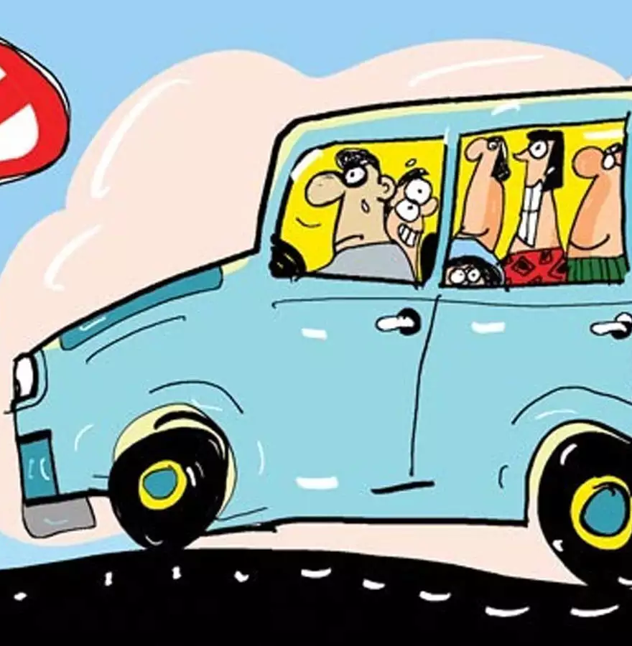
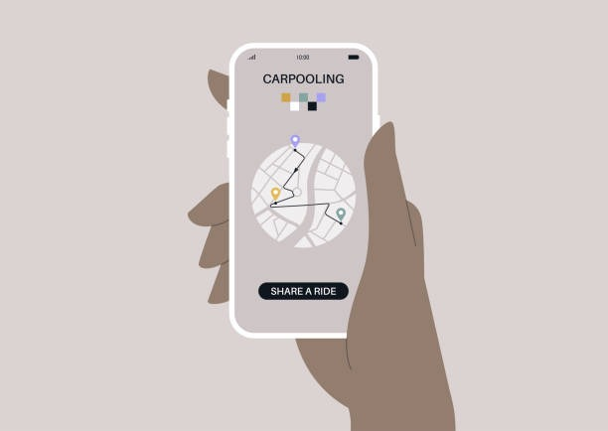
Case Study
Carpooling Application

Slide 7
Case Study 2
We shall collect the following data from the students.
Students living outside the campus, distance from the campus, distance to the places they regularly visit in the campus (say classrooms/SAC/Bovee), people who have car and is willing to pool with fellow students.
b) We can cluster the people based on different factors such as
People attending same class(since they will go to same department building).
People going to various buildings such as SAC, Bovee, Library, Grawn Hall etc,
People going to part times (Dine N Connect, Robinson, Eatery) .
c) Once we gather the respective data, we start developing the routes based on the distance using algorithms like Dijkstra's algorithm to find the shortest path and develop a certain route for a particular student who is willing to pool. That particular student will get a designated route where he can pick up the people going along his route and drop them off. Once he is done with his class/work he will again have a designated route back to his destination where he picks up and drops off. Here, neither the person who is pooling the car nor the person who is about to board it and travel will not be deviated from his regular travel time since we shall develop the application to match the same routes or try to minimize to least deviation possible.
d) Charge based on the distance.
e) We can introduce the same with respect to outside the campus locations like (Walmart, Aldies, Ricks, Meijer)

Slide 8
Case Study 2
Challenges And Obstacles:
There might not be students from a particular area, so people requesting from that area might have to wait longer times to get a ride or sometimes may not have a ride at all.
Will need an emergency response team if there’s a crash or trouble with the car in the midway.
Fares might increase with increase in gas prices.
Since mileage differs with respect to car fares might differ with respect to car and car size, if more people board cost might be less.
People who want to travel in weekends might face an issue since very less people tend to move around campus in the weekends and holidays.
If there is a change in time of a particular students class or cancellation of class it might effect others as well.
People going to grocery stores might not get a ride back home with enough space for their commodities
People might cancel the ride once after the car pooling person has reached the destination for different reasons.
People might be afraid to get into a stranger car hence make sure the app doesn’t go out of CMU student.
Students behavior towards others in the car.

Slide 9
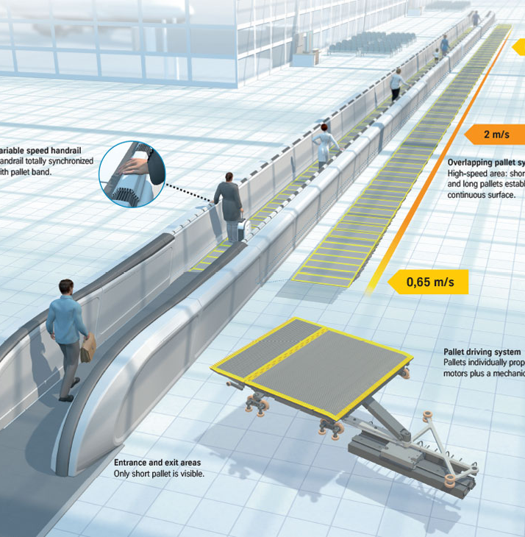
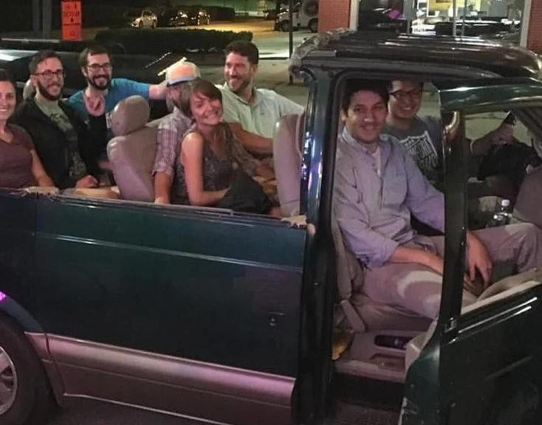
Case Study
Moving Walkways and transportation service

Slide 10
Case Study 3
We can arrange/construct moving walkways around the campus just like in airports and walkways must be powered by solar panels which are used as a roof for the walkway.
Challenges And Obstacles:
The challenges faced by this idea is in winters there might be heavy snow so the walkways might be filled with snow but to overcome that we can build fiber walls making an arch around the walkway protecting it from snow and rains.
Implement a transportation service that runs continuously through the radius of Mount Pleasant. At any point of time there are people moving around to different places in Mount Pleasant say bank appointments, Walmart, Ricks, Aldie, Meijer, UPS, McD, Hair Saloon, Coffee etc., so by continuously running a public transport like a mini bus.Let’s set up stops at various points and design a route to main centers.Since we can accommodate more number of people at a time we can reduce the cost, traffic on the roads can be reduced.

Slide 11
Case Study 3
Challenges and Obstacles:
Marketing should be done in such a way that people should start using public transport instead of their own transport.
Challenges for people to walk from their home to the stop (we can solve this issue by putting e bikes)
Make sure everything runs continuously and stays punctual.

Slide 12
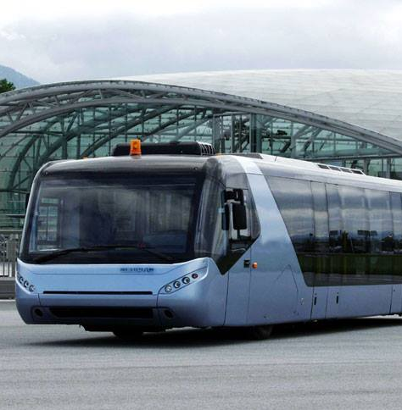
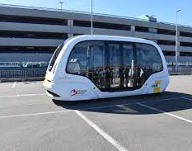
Case Study
On request Shuttle

Slide 13
Case Study 4
To provide on request shuttles during long weekend and vacation times so that students without car can travel to cities/airports. If a student wants to travel to some other destinations but he/she doesn’t have any car to travel so they can go through the central website for reserving a spot for the bus which is scheduled based on convenient time for all students on the weekends so the app starts to count the no of passengers willing to travel to Lansing or Detroit based on the strength reserved the spots and with that data campus can provide the transportation accordingly by assigning a car if the strength is 5 and a minibus if it goes up or else huge buses for large number of students and while returning it can plan the travel in reverse by collecting all the students travelling from different places to central by finding out the shortest path among the pickup locations towards central and indicating the time of pickup to the spot reserved student before hand after developing an itinerary of the trip.
Challenges and Obstacles:
Challenges faced by this idea are while returning from their home towns to University they might not get the itinerary until the day of travel if a small vehicle is not arranged to overcome this, we can do prebooking of it so that we can plan the travel date and time according to the no of people travelling from particular location. By using this method, it saves a lot of fuel by pooling customers to similar destinations and decreases the energy and resource usage causing less damage and pollution.

Slide 14
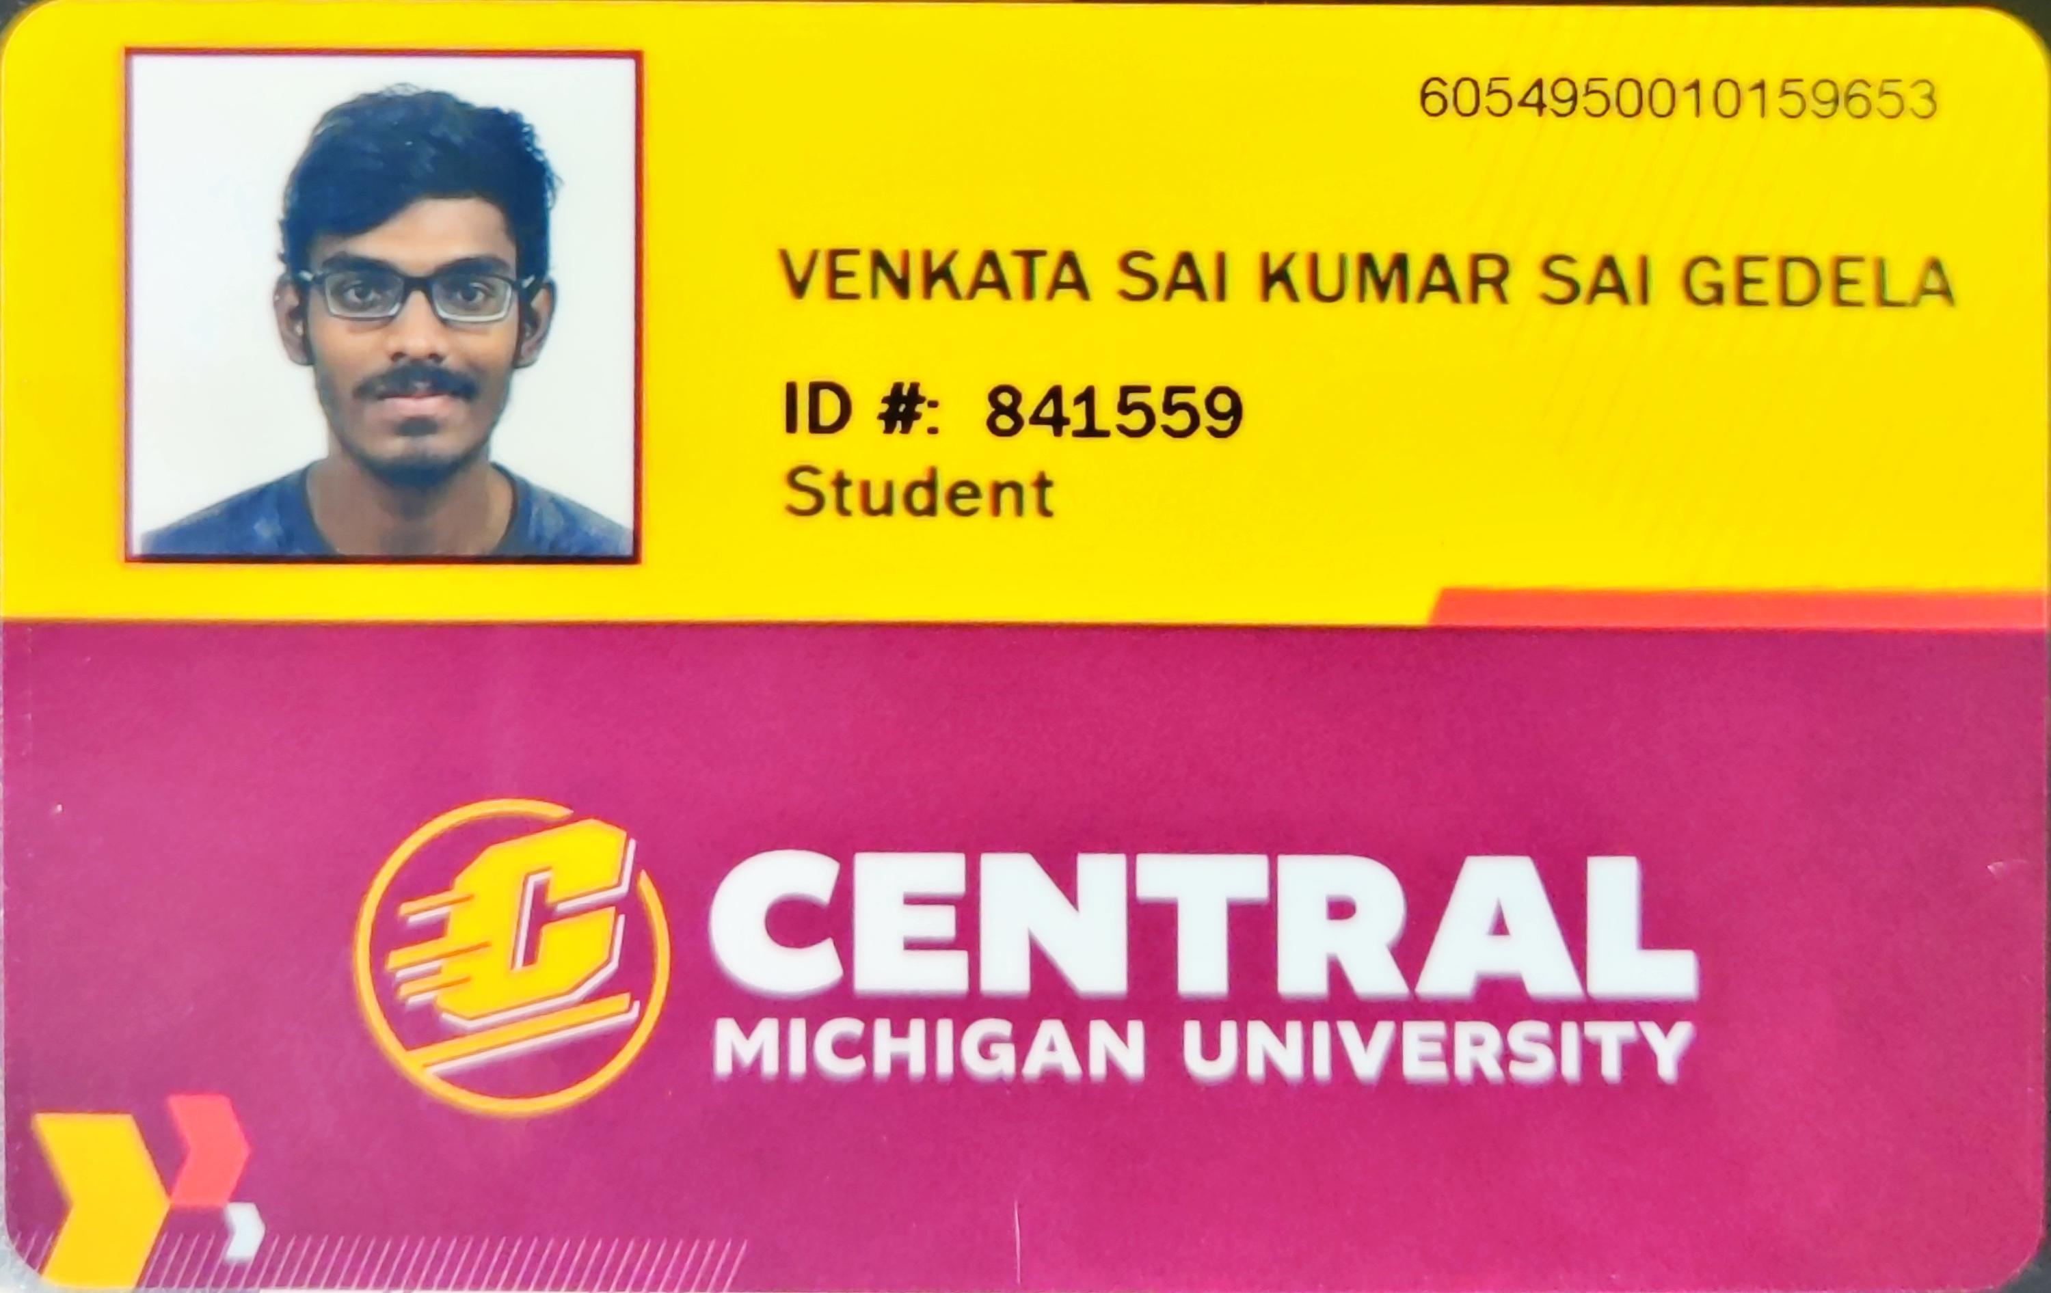
Team
Venkata Sai Kumar Gedela
Vamshi Jaligama
Sri Sai Phaneesh Potharaju

Slide 15





Thank you
College Of Science & Engineering
CENTRAL MICHIGAN UNIVERSITY
College of Business Administration
CENTRAL MICHIGAN UNIVERSITY
College Of The Arts & Media
CENTRAL MICHIGAN UNIVERSITY
T-MOBILE
FORD

